Slide 1

Turning patterns into profit
Retail Sales Forecasting

Slide 2
Project 3 Meg estey, Curtis caile, chris joncha, dave Borowski and brooke crofts
Descriptive Analytics
Predictive Analytics
Prescriptive Analytics

Slide 3


Keys to Success
Business Trends
Customer Base
Cyclical Trends
Loyalty vs. New Customers
Trends in purchase vs. returned items

Slide 4
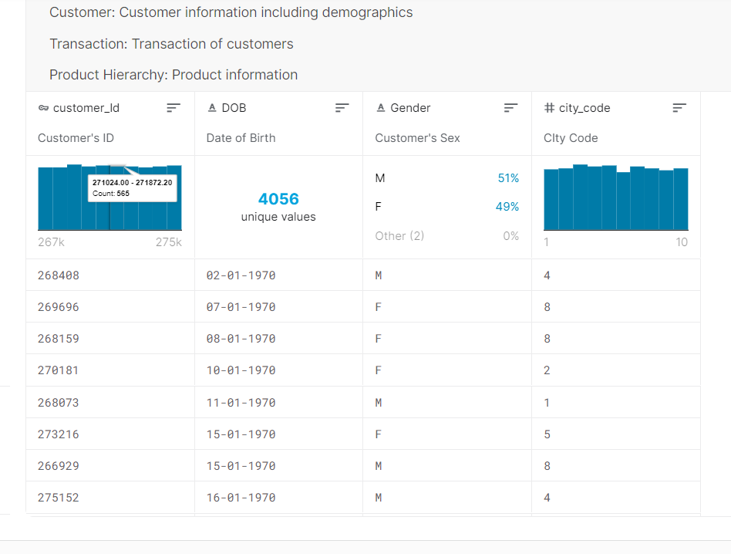
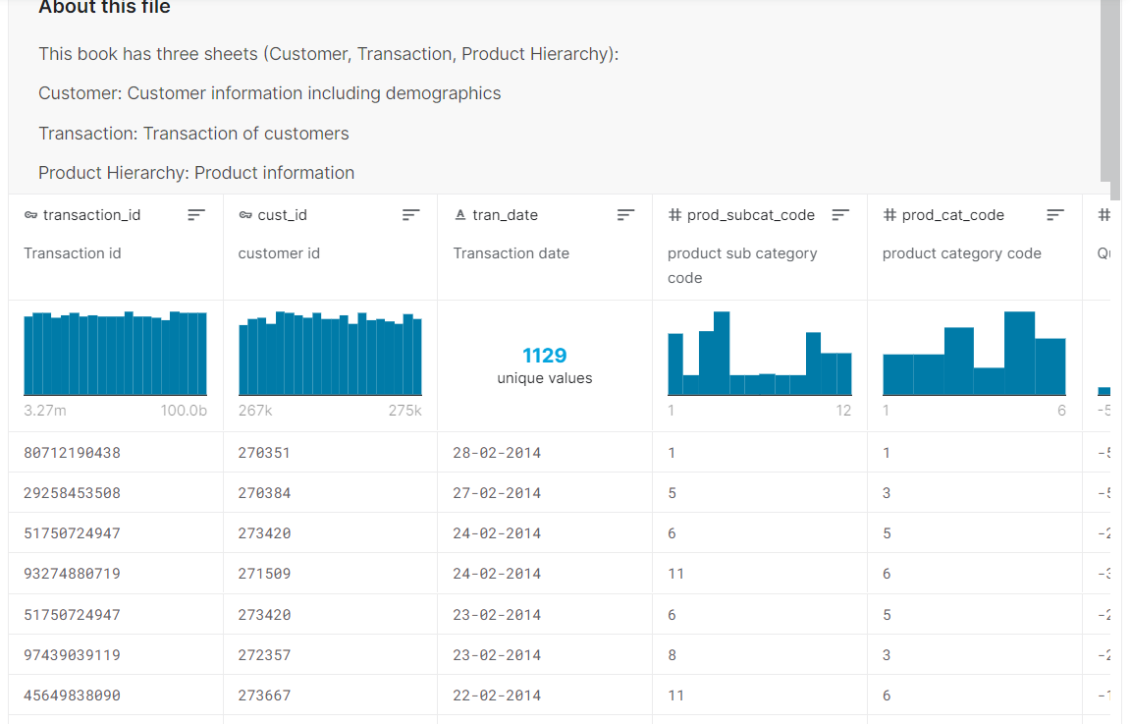
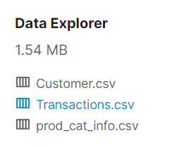
Kaggle
Retail Shop Case Dataset

Slide 5
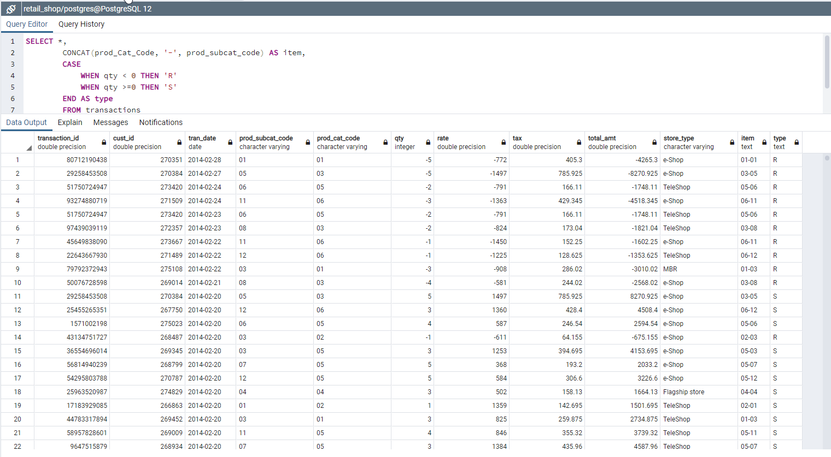
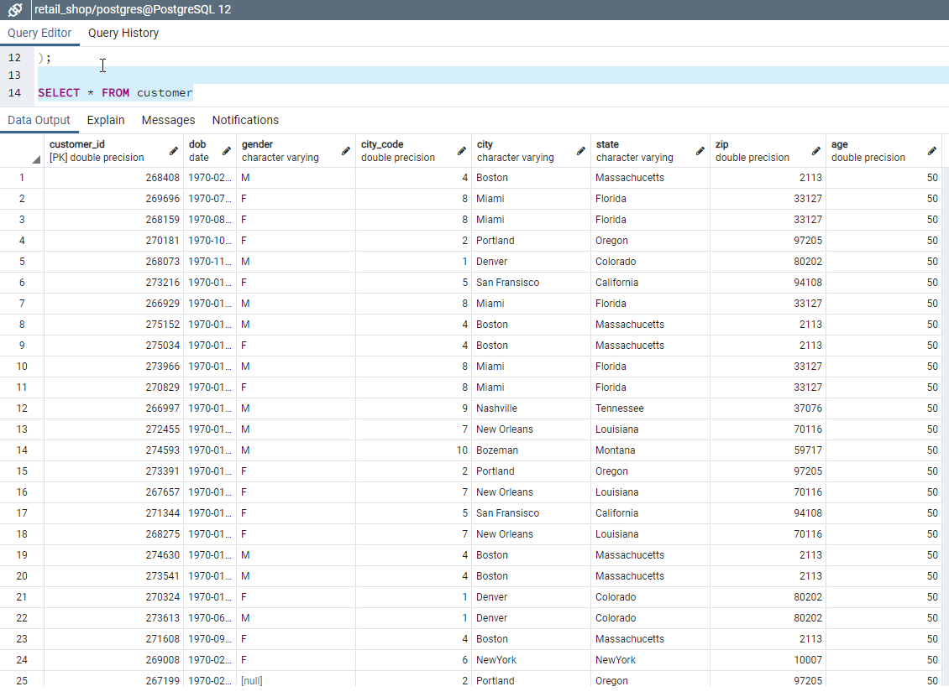
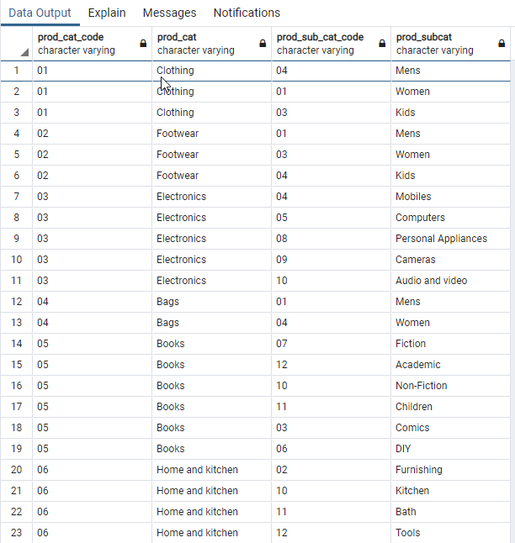
Data Cleaning
CSV Merges
Datetime Format
City Code Designation
Sales vs. Returns
Postgres SQL Database

Slide 6

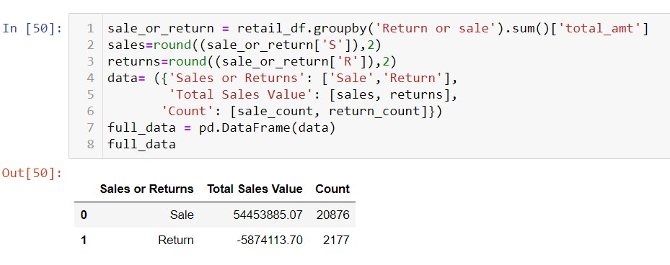

Descriptive analytics

Slide 7
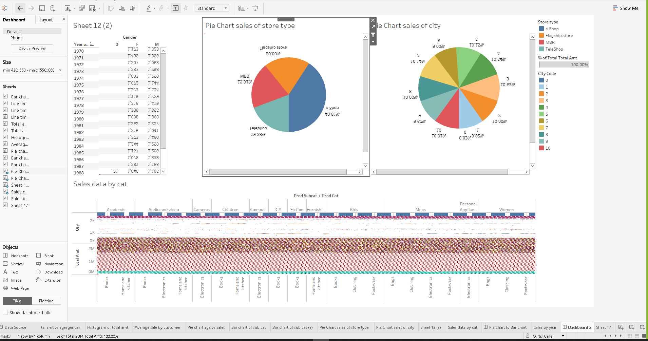
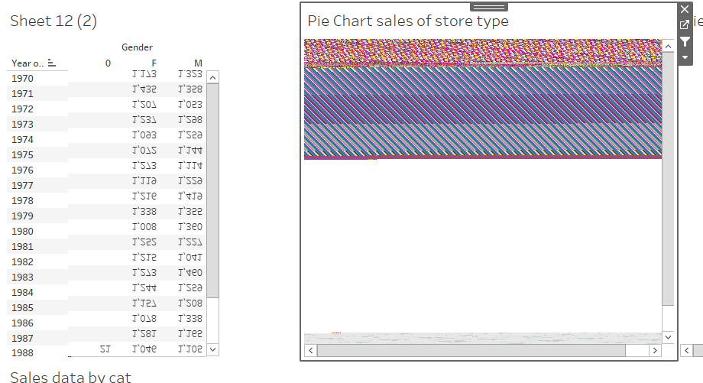
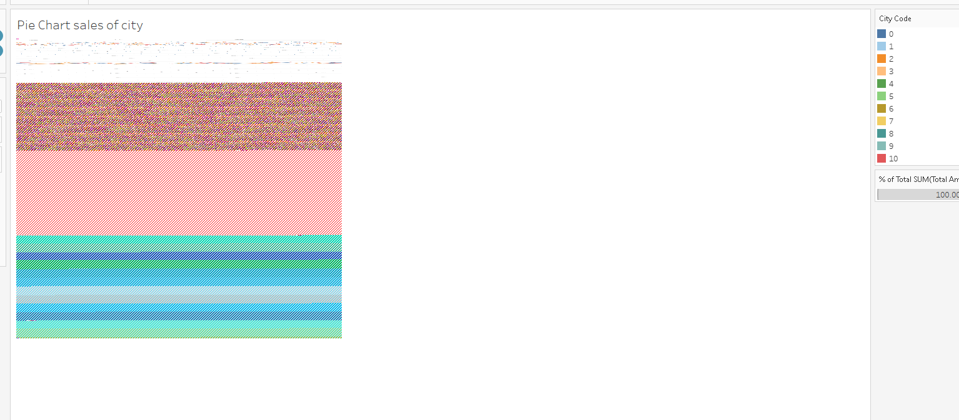
“Fun” with data

Slide 8

Predictive analytics
Machine Learning

Slide 9
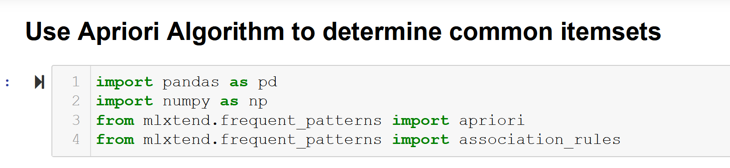
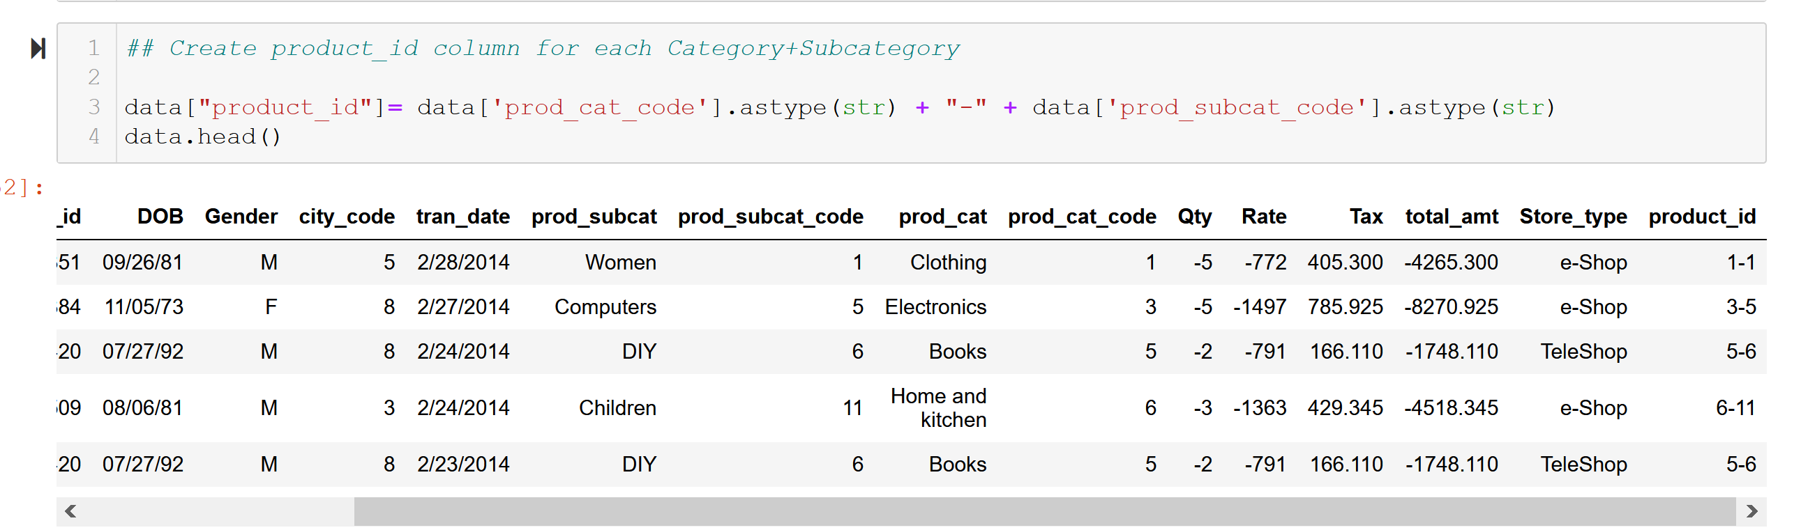
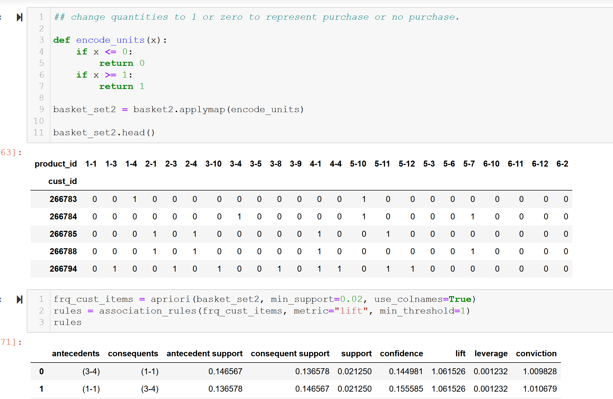
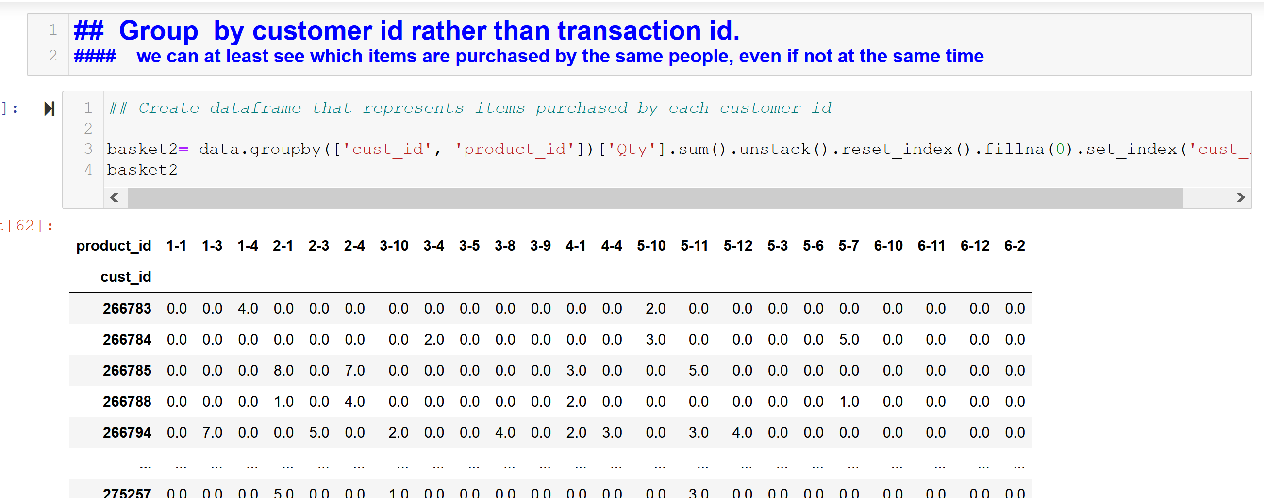
Machine Learning_______

Slide 10
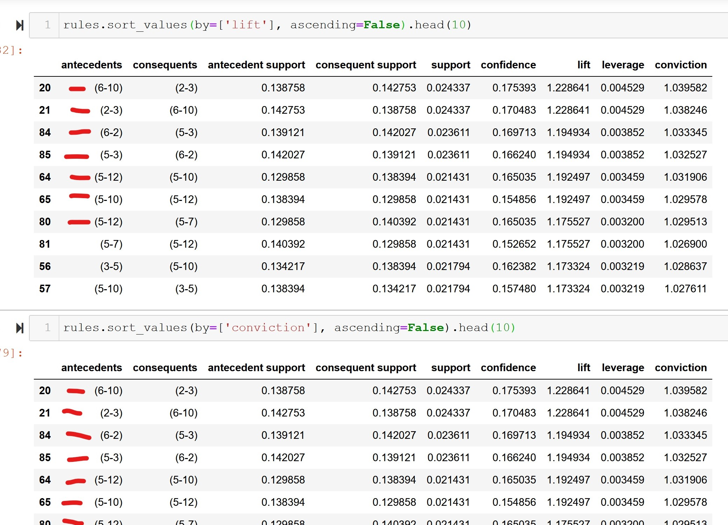
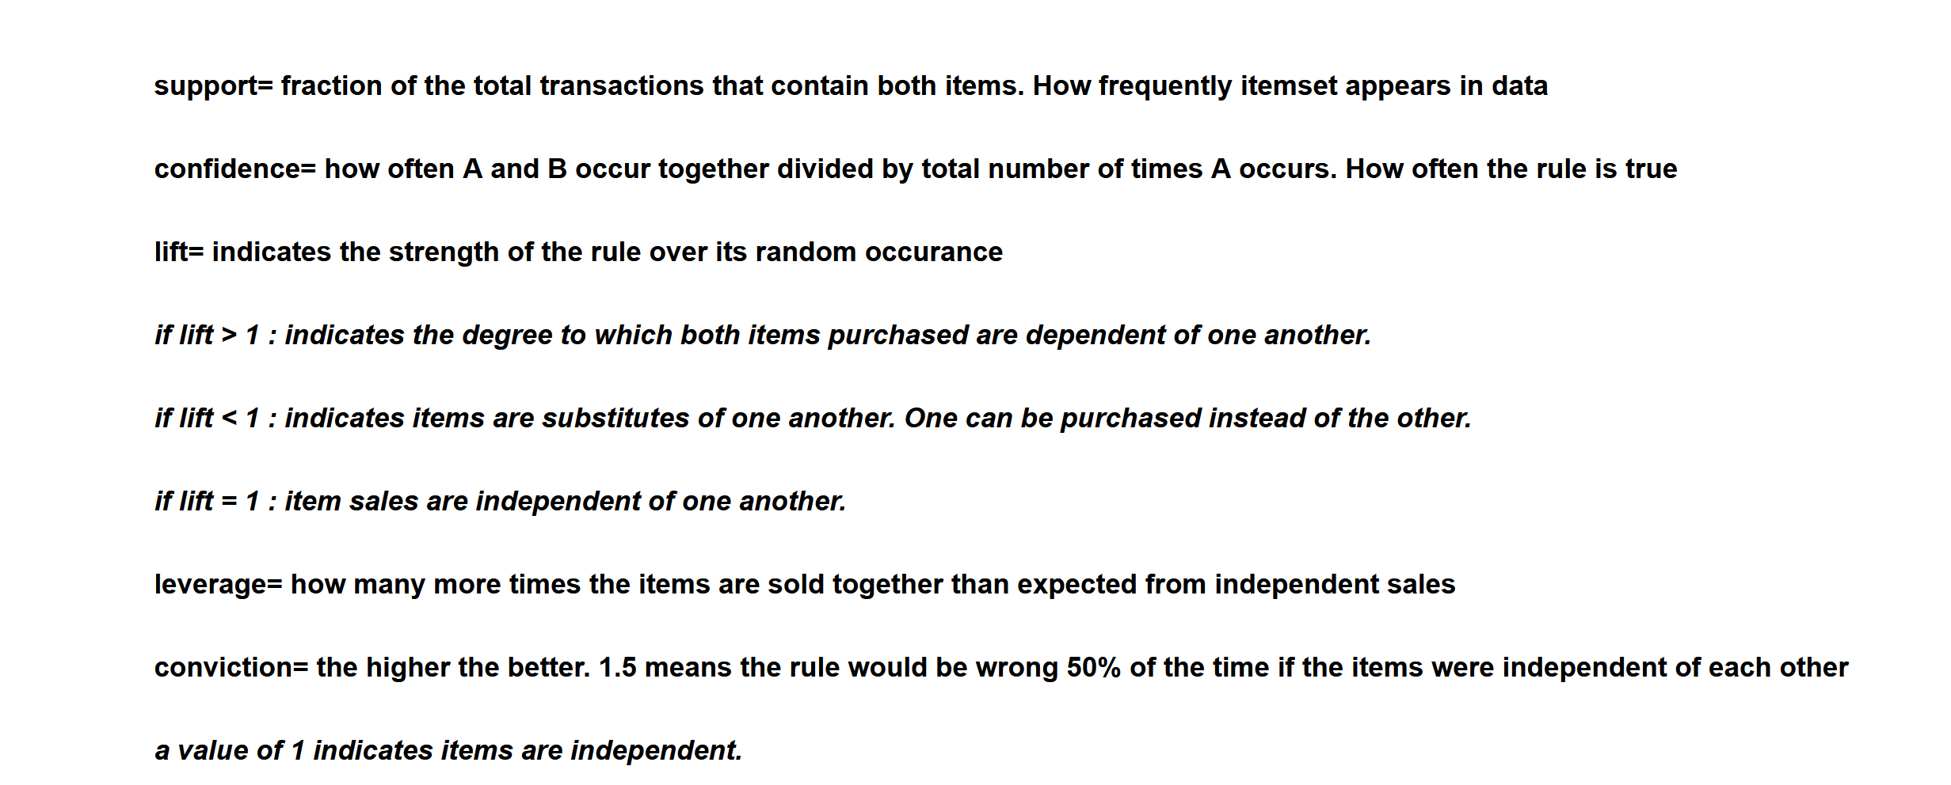
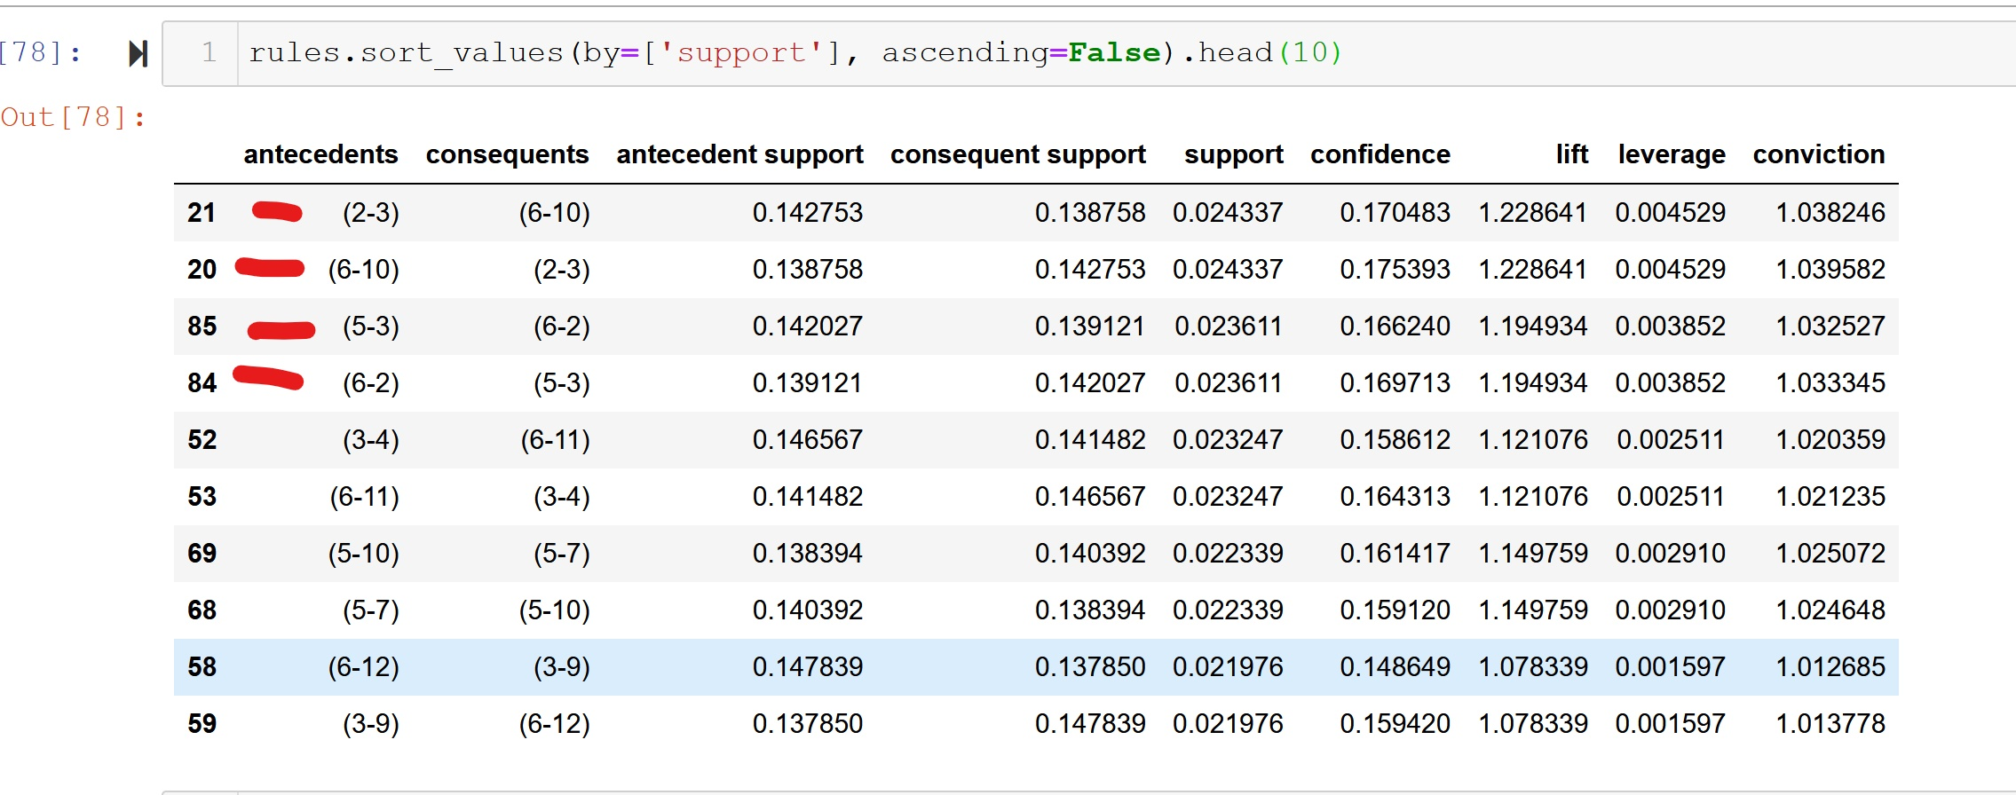
Machine Learning_______

Slide 11
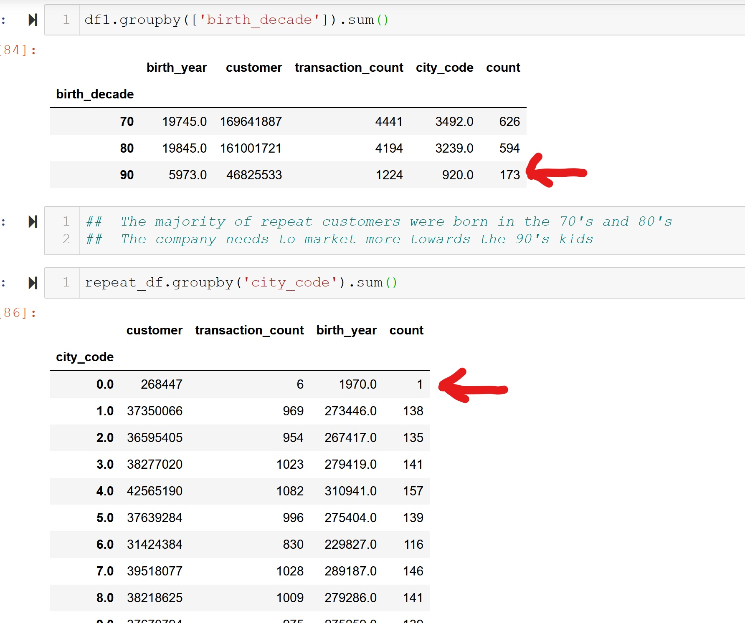
Prescriptive analysis
PYTHON
________
Repeat Customer Demographics
All customers included in this data have at least 6 purchases

Slide 12
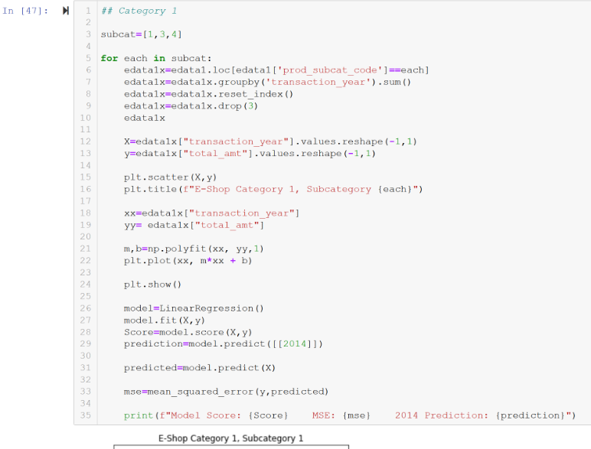
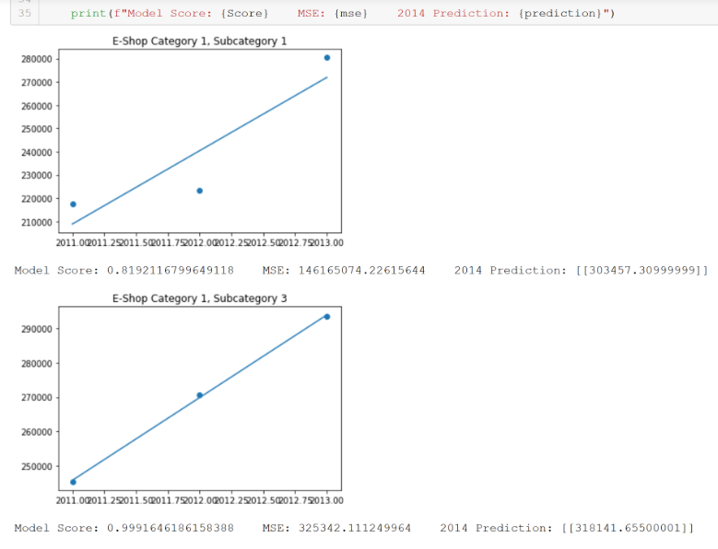

E-Shop Category 1 predictions for 2014

Slide 13
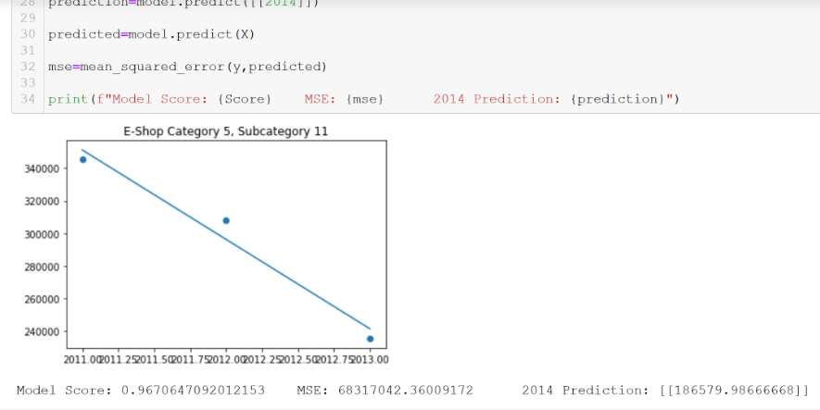
E-Shop Category 5 predictions for 2014

Slide 14
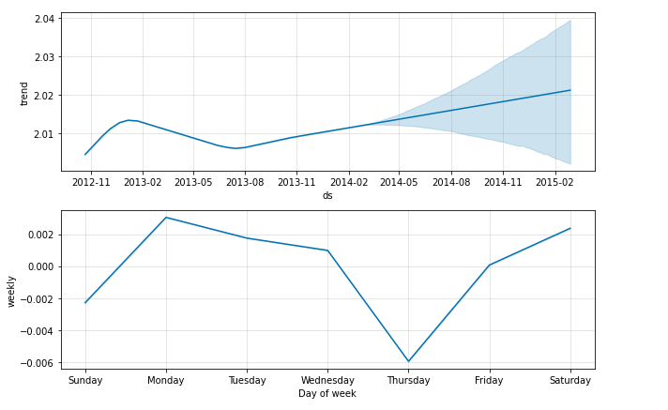
Prescriptive analysis
PROPHET
________
Sales Forecast Predictions

Slide 15

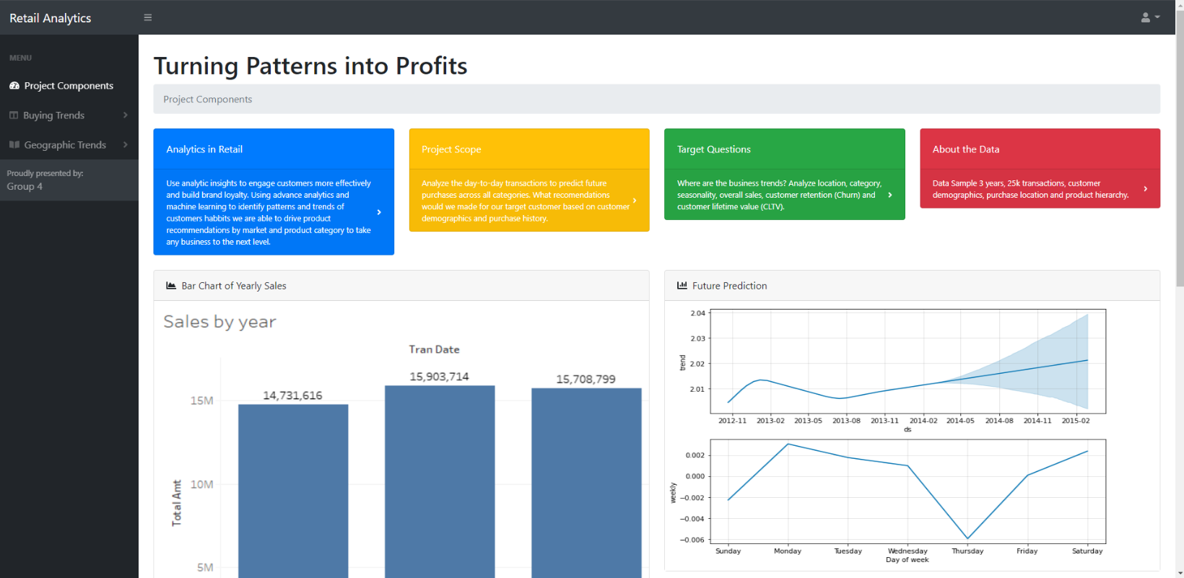
Web page
Interactive Web Page
Links to:
JSON Data
Tableau Public

Slide 16


Thank You!
Team 4 – 2020 Bootcamp
Available for hire

